Slide 1


CAM PRO
(A JAVA APP BASED ON IP CAMERA)
GUIDED BY:
Prof. Rajesh K. Ahir
PRESENTED BY:
Sunil Lakkad(100110107024)
Vivek Gupta(100110107057)

Slide 2
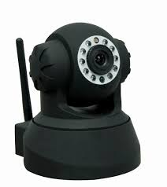
PROJECT DESCRIPTION
Team Member : 2
Project Type: UDP
Technologies:
Java Development

Slide 3
INTRODUCTION
CAM PRO – an Java Based Application for IP Camera will be a tool that will provide its users with higher security and more monitoring power to a place by using the cameras.
IP Camera is a new generation product with the combination of analog camera & IP video technology
One of the biggest benefits of having IP cameras is being able to access them from the internet.

Slide 4
OBJECTIVE
Develop a tool to test IP Camera.
Develop a tool to display the data being sent from IP Camera to the user.
Maintain details of users who have privileges to use this tool

Slide 5
OBJECTIVE (CONTD..)
Business Function:
Login
User Maintenance
IP Camera Stream feed

Slide 6
USERS
• Administrator: Administrator will be the super user of the system having all the privileges. Administrator will be responsible to add, delete and assign privileges to the other users of the system.
• Employee: Employee is the member of staff of the organization using this application. Employee will be having limited privileges as assigned by the administrator. They will be responsible for testing of IPCamera.

Slide 7
TECHNOLOGY TO BE USED
•Java
Java is a platform independent, object-oriented, robust, secure and innovative programming language.
• Database Programming
  JDBC
• Windows Programming
  Swing

Slide 8
SOFTWARE REQIREMENT
•JDK 1.6
  NetBeans 6.5.1
•JDBC Driver for MySQL Database Server
  mysql-connector-java-5.1.7-bin.jar
•Database Server
  MySQL Database Server 5.0
•Operating system
  Windows Vista / XP/7/8/8.1

Slide 9
Hardware Requirements
1. Intel P4 processor with minimum 2.0Ghz Speed
2. RAM: Minimum 512MB
3. Hard Disk: Minimum 20GB

Slide 10
LITERATURE SURVEY
How To configure IP Camera ?
How to access IP Camera from any where ?
How to Provide Static IP Address to IP Camera?
How to forward Port address from Router?

Slide 11
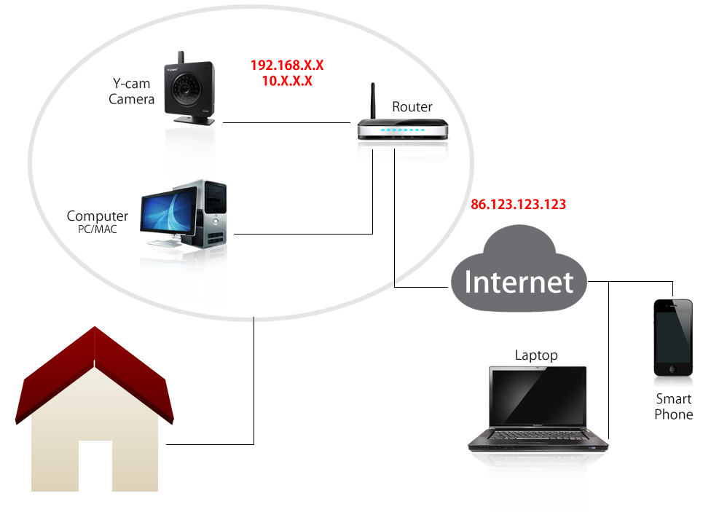
ACCESSING IP CAMERA FROM THE INTERNET

Slide 12
STEP 1: CONFIGURING IP CAMERA
By default, most IP cameras are assigned a temporary IP address by your router.
The problem with this is that it’s likely that this address will change next time turn off and then back on the router or camera.

Slide 13
STEP 2: PORT FORWARDING
This is to update your routers firewall.
By default, the router has what is called a firewall and its job is to block anyone trying to get into your network including you. You have to define which devices can been accessed from the internet.

Slide 14
STEP 3: ACCESSING IP CAMERA
When you are home, you access the camera using what is called the LAN address.
To access the cameras remotely, you need its WAN address.
This is the address that the router uses to connect to your cable or DSL service provider.

Slide 15
STEP 4: ASSIGNING HOST NAME
Service providers have many, many customers and it would be very expensive to give each and every one of us a fixed IP address as you did with your camera in step 1. So they use DHCP and assign you temporary IP address and that can change.
The way it works is a DDNS company assign you a host name, like myhome.dyndns.com and then your router or camera has the ability to keep this up to date every time your service provider changes the WAN IP address.

Slide 16
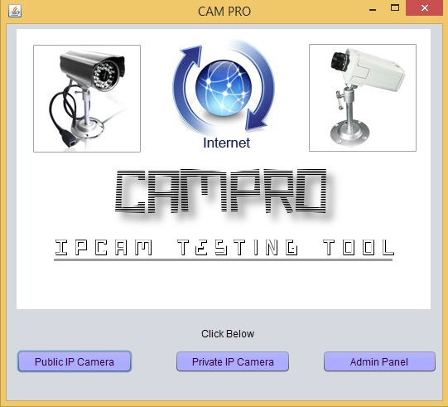
SCREENSHOT 1 MAIN SCREEN OF THE APPLICATION

Slide 17
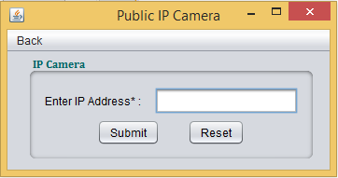
SCREENSHOT 2 PUBLIC IP CAMERA SCREEN

Slide 18
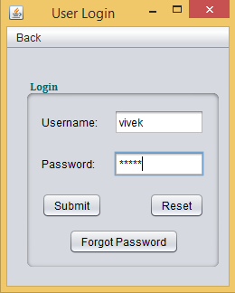
SCREENSHOT 3 USER LOGIN SCREEN

Slide 19
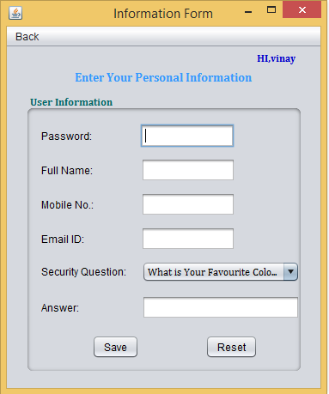
SCREENSHOT 4 USER LOGIN FORM SCREEN

Slide 20
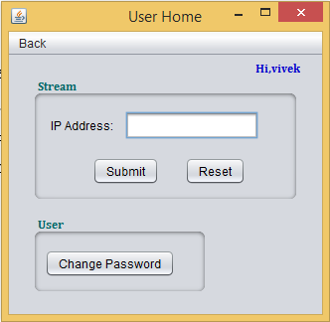
SCREENSHOT 5 USER HOME SCREEN

Slide 21
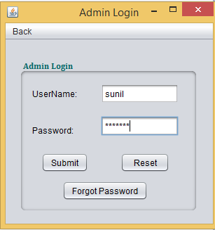
SCREENSHOT 6 ADMIN LOGIN SCREEN

Slide 22
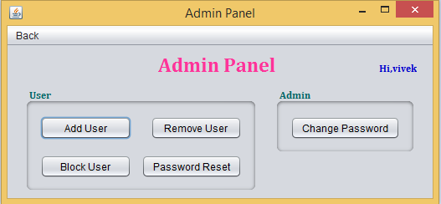
SCREENSHOT 7ADMIN PANEL SCREEN

Slide 23
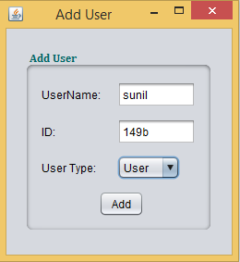
SCREENSHOT 8 ADD USER ADMIN PANEL SCREEN

Slide 24
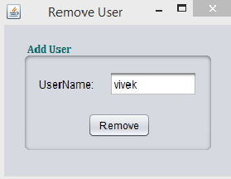
SCREENSHOT 9 REMOVE USER ADMIN PANEL

Slide 25
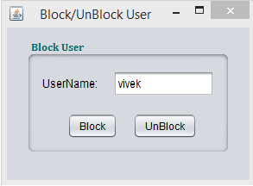
SCREENSHOT 10 BLOCK/UNBLOCK USER ADMIN SCREEN

Slide 26
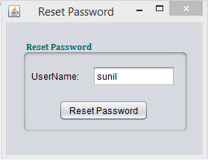
SCREENSHOT 11 RESET PASSWORD OF USER ADMN PANEL

Slide 27
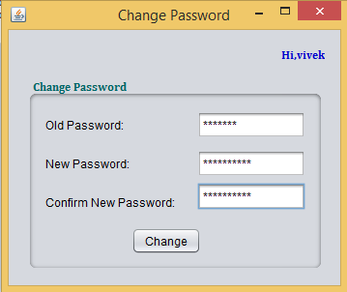
SCREENSHOT 12 CHANGE PASSWORD SCREEN

Slide 28
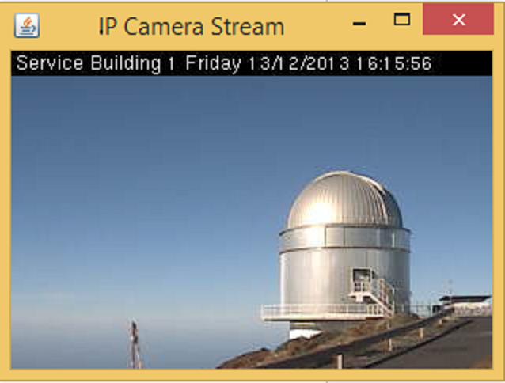
SCREENSHOT 13 IP CAMERA STREAM

Slide 29
DEMO OF APPLICATION
VIDEO: ScreenCapture_12-15-2013 11.49.37 PM.xesc

Slide 30
REFERENCE
Books Referred:
The Complete Reference Java 2, Herbert Schildt , Tata McGraw-Hill
Pure JFC Swing, Dr Satyaraj Pantham, PHI
Professional Java Programming, Brett Spell, SPD
Websites:
Http://www.sun.java.com
https://jdic.dev.java.net/
http://stackoverflow.com/questions/tagged/java
http://en.wikipedia.org/wiki/IP_camera
www.edimax.com/.../IP-Camera/...IP-Cam/ConfigureIPcam
www.spyonabird.com/pdf/upnp-port-web.pdf‎

Slide 31
THANK YOU

